Slide 1


The Coming Big Data Tsunami in Energy Market Analytics

Slide 2

We are a Research & Software Development firm
We help companies find and create value with their data using mathematics and computer science techniques
Jeff Fong
Co-Founder, Data Scientist
Chief Product Architect
Michael Simantov
Co-Founder, Data Scientist
Chief Quantitative Researcher

Slide 3
Outline
Why are Big Data & Analytic concepts important in Energy Markets?
What is Big Data & Analytics?
A “small” Big Data & Analytics example
Big Data, Analytics and Energy Markets
Getting started if you haven’t already

Slide 4
Why are Big Data & Analytic concepts important in Energy Markets?

Slide 5
Big Data & Analytics
The Past: A competitive advantage was often obtained with an asset.
Railroads, pipelines, refineries

Slide 6
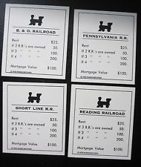
Big Data & Analytics
The Past: A competitive advantage was often obtained with an asset.
Railroads, pipelines, refineries

Slide 7
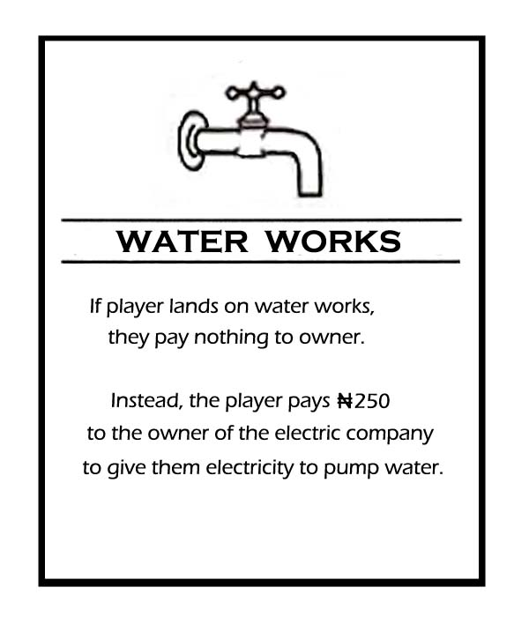

Big Data & Analytics
The Past: A competitive advantage was often obtained with an asset.
Railroads, pipelines, refineries,
Water utilities
Power generation

Slide 8

Big Data & Analytics
The Past: A competitive advantage was often obtained with an asset.
Railroads, pipelines, refineries,
Water utilities
Power generation
Asset based
competitive advantage
Monopolies

Slide 9
Big Data & Analytics
What we see today is a trend where analytics revolutionize industries
Lower capital intensive industries were first
We have already seen many industries revolutionized by companies that specialize in data and analytics (Google, Amazon)
Advertising and Sales
Logistics
Travel and Airlines

Slide 10
Big Data & Analytics
What we see today is a trend where analytics revolutionize industries
Lower capital intensive industries were first
We have already seen many industries revolutionized by companies that specialize in data and analytics (Google, Amazon)
Advertising and Sales
Logistics
Travel and Airlines
Energy markets are next!
The data is being stored
Sufficient processing power is now available
Markets are becoming integrated

Slide 11
Big Data & Analytics
As energy markets continue to become more global, the competitive advantage from analytics will continue to grow
increased integration of global energy markets
new pipelines, transmission, energy technologies
growing amounts of data
increased competition and demand response
integration with financial markets
The future of strategic discussions will include include data analytics and algorithms as being competitive advantages

Slide 12
What is Big Data & Analytics?

Slide 13
What is “Big Data & Analytics”
“Big” is relative
data starts to become big when you can’t make use of the raw data without summarizing it
Three types of analytics
Descriptive
Predictive
Prescriptive

Slide 14
Analytics: Descriptive
Most data in its raw form is not suitable for human consumption
Data must be condensed into useful pieces of information
The purpose of descriptive analytics is to summarize what has happened
The focus is on learning about your data (data discovery)
80% of business analytics is descriptive (think about your BI reports)

Slide 15
Analytics: Descriptive
Averages, variance, correlations, principle components, distributions and summary statistics are all descriptive
They help you learn about your data, but are not in themselves, predictive or prescriptive
Example: How do interest rates, spot prices and volatility move together?

Slide 16
Analytics: Predictive
Predictive analytics do not tell you will happen; it tells you what might happen. (probabilistic)
In other words, using data you do have; fill in data you don't have
predict possible future data
fill in possible values for missing data

Slide 17
Analytics: Predictive (=modeling)
Predictive analytics do not tell you what will happen; it tells you what might happen. (probabilistic)
In other words, using data you do have; fill in data you don't have
predict possible future data
fill in possible values for missing data
Model building is a big part of predictive analytics
Statistical models, data mining, machine learning, time-series, monte-carlo simulation, forecasting, neural nets are all predictive
They tell you what might happen, but not what to do about it

Slide 18
Analytics: Predictive
Example: ‘Predict’ or model the value of an OTC call option
We use data we have (interest rates, spot prices and volatility) to predict data we don’t have (the call option value)
VXX
SPY
TLT

Slide 19
Analytics: Predictive
Example: ‘Predict’ or model the value of an OTC call option
We use data we have (interest rates, spot prices and volatility) to predict data we don’t have
Possible future interest rates, spot prices and volatility
And possible future option values
VXX
SPY
TLT
CALL Option

Slide 20
Analytics: Prescriptive
Using our data, descriptive analytics and predictive models
We can prescribe an action that best achieves an objective
Prescriptive analytics needs “actionable data”
What actions can be taken that affect outcomes?
What are the objectives?
VXX
SPY
Minimize risk?
Maximize reward?
Maximize Sharpe ratio?
TLT
CALL Option

Slide 21
Analytics: Prescriptive
Example: Actions to hedge a call option
We have the data for interest rates, spot prices & volatility
We have a predictive model for an option price
Objective: Maximize return per unit of risk
VXX
Dynamic hedging is a prescriptive strategy
delta / gamma hedge
hedge greek exposures
SPY
TLT
CALL Option

Slide 22
A “small” Big Data & Analytics example

Slide 23
A Portfolio Trading example
SPY - S&P500 index
TLT - 20+ year Treasury bonds ETF
VXX – S&P500 Volatility ETF
VXX
SPY
TLT

Slide 24
A Portfolio Trading example
Mini universe of 9 stocks and ETFs
SPY - S&P500 index
TLT - 20+ year Treasury bonds ETF
VXX – S&P500 Volatility ETF
JNK - High yield corporate bond ETF
UGA - Gasoline futures ETF
VLO - Valero Energy Corp (refinery)
USO - Oil (WTI) futures ETF
JO - Coffee ETF
SBUX - Starbucks
VXX
SPY
TLT

Slide 25
A Portfolio Trading example
Mini universe of 9 stocks and ETFs
SPY - S&P500 index
TLT - 20+ year Treasury bonds ETF
VXX – S&P500 Volatility ETF
JNK - High yield corporate bond ETF
UGA - Gasoline futures ETF
VLO - Valero Energy Corp (refinery)
USO - Oil (WTI) futures ETF
JO - Coffee ETF
SBUX - Starbucks
Complex
dynamics
JO
SBUX
VXX
SPY
VLO
TLT
USO
JNK
UGA
How can we methodically construct a trading strategy?

Slide 26
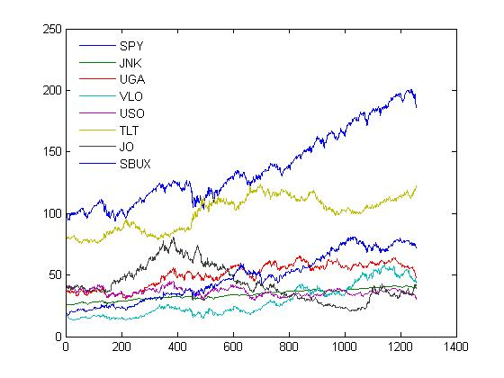
Descriptive
Mini universe of 8 stocks and ETFs
Calculate:
means, variances
correlations, autocorrelations
principle components
Discover features about this dataset

Slide 27
Predictive
This “small” example isn’t really that small. There are 2^8=256 possible combinations of underliers to include, each with endless possibilities of share combinations
With some data mining (We’ll make the code available for you to try yourself), we can build a (predictive) model of a cointegrated portfolio from our mini universe of stocks and ETFs

Slide 28
Predictive
This “small” example isn’t really that small. There are 2^8=256 possible combinations of underliers to include, each with endless possibilities of share combinations
With some data mining (We’ll make the code available for you to try yourself), we can build a (predictive) model of a cointegrated portfolio from our mini universe of stocks and ETFs
In otherwords, we can build a portfolio that mean reverts using predictive (modeling) analytics

Slide 29
Predictive
Mini universe

Slide 30
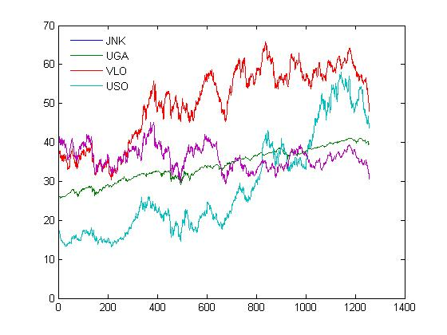
Predictive
Mini universe
Data-Mined subset

Slide 31
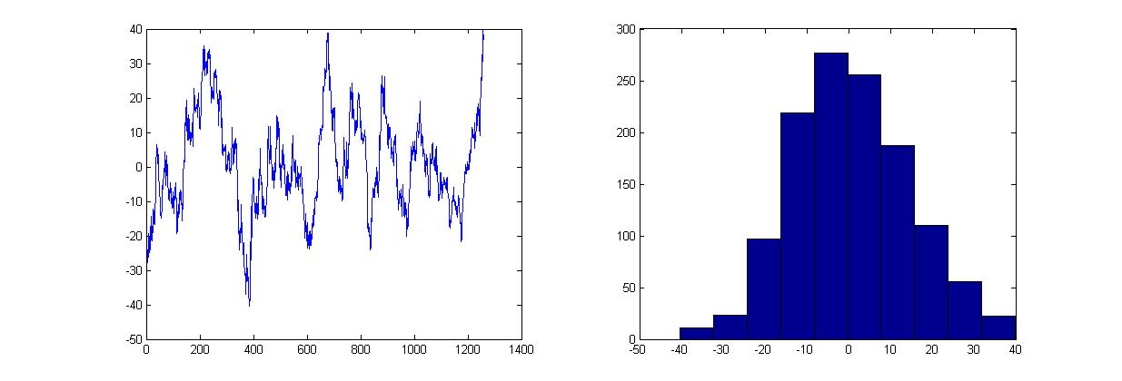
Predictive
Mini universe
Data-Mined subset
Cointegrated portfolio allocation
long 7.0136 shares of JNK @ $40.31 = $282.72
short 2.0775 shares of UGA @ $48.87 = ($101.53)
short 1.2010 shares of VLO @ $48.36 = ($58.08)
short 2.7351 shares of USO @ $30.64 = ($83.80)

Slide 32
Predictive
5 year history of the net value of the model cointegrated portfolio

Slide 33
Predictive
Mean Reversion Level
5 year history of the net value of the model cointegrated portfolio
Distribution of the net portfolio value over the 5 years

Slide 34
Predictive
Mean Reversion Level
Let’s create a simple (prescriptive) strategy with the objective being to generate trading profits!
This is not a recommendation! Do your own due diligence!

Slide 35
Prescriptive
BUY the portfolio when it’s at the 5th percentile
Let’s create a simple (prescriptive) strategy with the objective being to generate trading profits!
This is not a recommendation! Do your own due diligence!

Slide 36
Prescriptive
SELL the portfolio when it’s at the 95th percentile
BUY the portfolio when it’s at the 5th percentile
Let’s create a simple (prescriptive) strategy with the objective being to generate trading profits!
This is not a recommendation! Do your own due diligence!

Slide 37
Prescriptive
Cover at the Mean Reversion Level
SELL the portfolio when it’s at the 95th percentile
BUY the portfolio when it’s at the 5th percentile
Let’s create a simple (prescriptive) strategy with the objective being to generate trading profits!
This is not a recommendation! Do your own due diligence!

Slide 38
Prescriptive
Come back and ask me what happened in 6 months!
Cover at the Mean Reversion Level
SELL the portfolio when it’s at the 95th percentile
BUY the portfolio when it’s at the 5th percentile
Let’s create a simple (prescriptive) strategy with the objective being to generate trading profits!
This is not a recommendation! Do your own due diligence!

Slide 39
Big Data, Analytics and Energy Markets

Slide 40
Energy Market Big Data Analytics
Modeling energy markets is a difficult and complex problem
complex distributions
large constrained optimization problems
market feedback loops
Problems in energy markets, get very big, very fast!

Slide 41
Energy Market Big Data Analytics
Digging into the details is like opening pandora’s box
If we look at a power plant, at its surface it seems simple
Power
Power
Plant
Gas
Basis

Slide 42
Energy Market Big Data Analytics
Digging into the details is like opening pandora’s box
If we look at a power plant, at its surface it seems simple
Once we peel back the surface, it gets complicated very fast
Load
Temp
Power
WTI
EIA
Power
Plant
Gas
Heating
Oil
Gas
Basis

Slide 43
Energy Market Big Data Analytics
Digging into the details is like opening pandora’s box
If we look at a power plant, at its surface it seems simple
Once we peel back the surface, it gets complicated very fast
What is the optimal hedge?
Load
What other assets complement my existing portfolio
Temp
Power
WTI
EIA
Power
Plant
How sensitive is my portfolio to EIA numbers?
Gas
Heating
Oil
What’s the impact of a transmission or pipeline disruption?
Gas
Basis

Slide 44
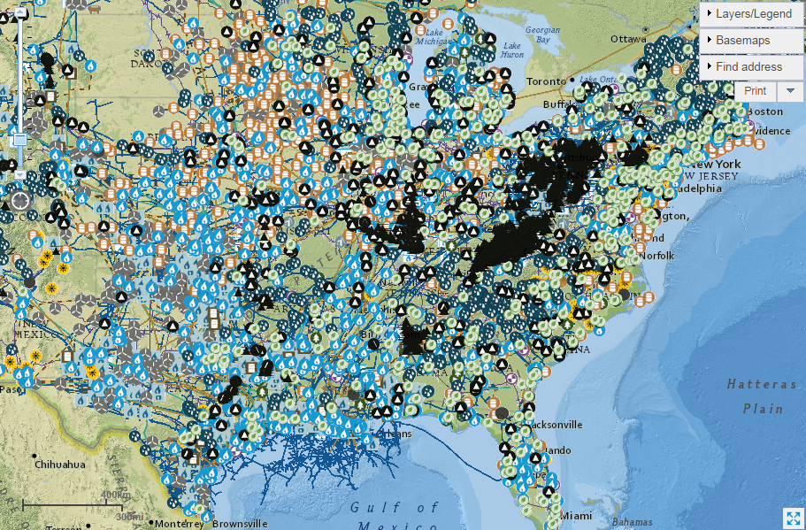
The “Real” World

Slide 45
The “Real” World
Hundreds of nodes and relationships
Dozens of different asset types
Many constraints and market rules to consider
A lot of analytics and software/hardware are required to analyze such complex problems

Slide 46
Energy Market Big Data Analytics
Even the largest problems can still be broken down
Use an analytics based approach to simplify the problems
Include top down quantitative methods with bottoms up fundamental based modeling
Leverage “Big Data” technology once its needed
Hadoop (reading / writing)
Distributed and cloud computing
(large scale computations)
Hadoop and distributed / cloud technologies can be extremely powerful in helping you solve large problems

Slide 47
Getting started if you haven’t already

Slide 48
Learn as much as you can!
Learn to work with and analyze large data sets
SQL (any will do)
Any good programming or statistical language such as R

Slide 49
Learn more!
Learn to work with and analyze large data sets
SQL (any will do)
Any good programming or statistical language such as R
Start by solving small optimization problems to gain experience
Free online universities and excellent courses
udacity, coursera, etc
Learn more about other fields where you have interests

Slide 50
Learn more!
Learn to work with and analyze large data sets
SQL (any will do)
Any good programming or statistical language such as R
Start by solving small optimization problems to gain experience
Free online universities and excellent courses
udacity, coursera, etc
Learn more about other fields where you have interests
Go write the ERP exam!

Slide 51
Gaining Adoption
Gaining adoption can be difficult at first
Start with small, easy to handle projects
Try descriptive analytics first
Focus on solving specific problems first to show ROI
Share results often and invite feedback
Incorporate feed back and use rapid prototyping
Teach & collaborate!

Slide 52
Resources
Free online courses
coursera.org
udacity.com
Open source software options
www.mysql.com
hadoop.apache.org
www.r-project.org
http://d3js.org
Javascript libraries
Commercial software options
www.tableausoftware.com
Matlab
MS SQL / Oracle

Slide 53
Questions?

